Slide 1
Reporting Data Warehouse

Slide 2
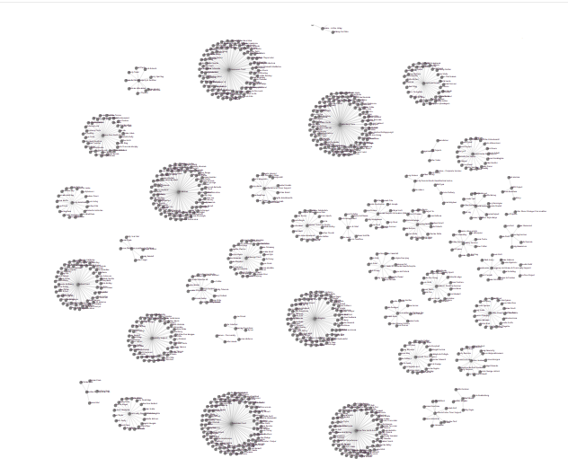
What is its purpose?
“To marshal an organisation’s data and bring it to business users for their decision making”
Ralph Kimball, 2013

Slide 3
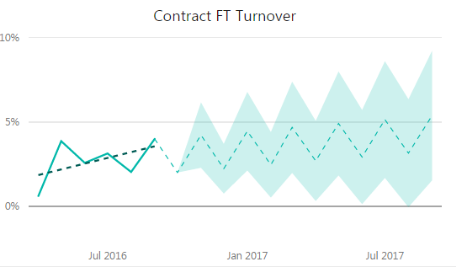
What can you do with it?
Make informed decisions
Evaluate data over time
Provide trends and forecasts
View data in many different perspectives
Combine data from disparate areas
Accessible from all devices

Slide 4

How does it work?
The Indian restaurant analogy
The kitchen
The dining area
Takeaway food

Slide 5
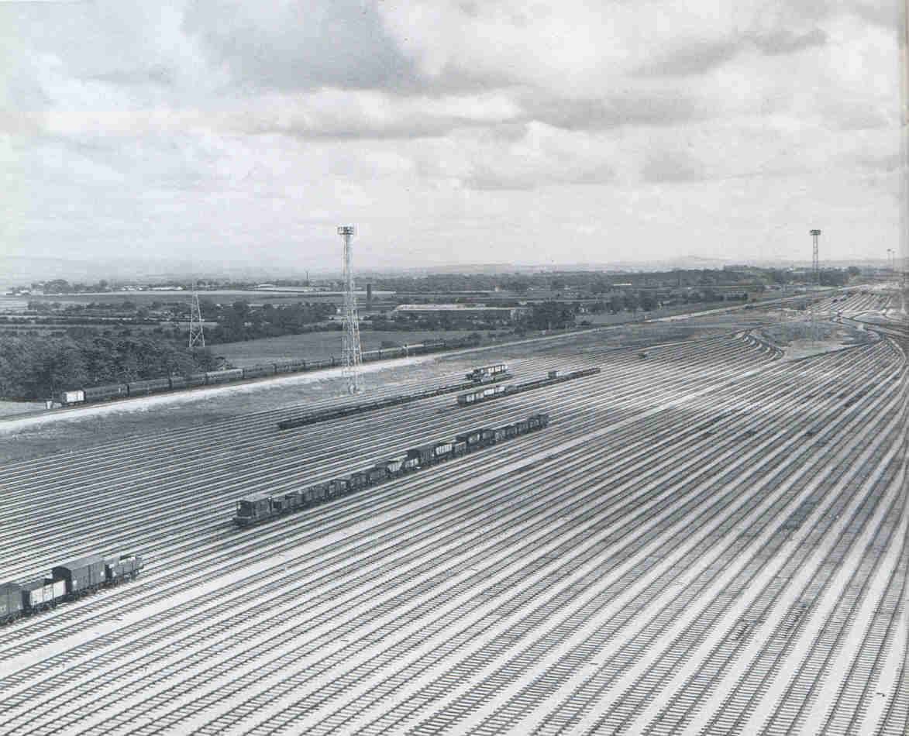
Progress so far
Warehouse cloud infrastructure established
Warehouse sub-systems in place
HR & Payroll data integrated
BOM data integrated

Slide 6

Next steps…
Integrate other systems
Train staff

